Slide 1



TEAM 2025108

Slide 2





Table of contents
01
Problem-statement overview
02
Exploratory Data Analysis
03
Feature Engineering
04
Budget Optimization
05
Dashboards

Slide 3









PROBLEM STATEMENT OVERVIEW
PROBLEM STATEMENT
OBJECTIVES
ElectroMart, a fast-growing e-commerce retailer, aims to maximize marketing ROI after heavy ad spending with limited revenue growth.
Key challenges include inefficient budget allocation, ineffective promotions, and a lack of integrated insights on seasonality and economic factors.
Key Performance Indicators (KPIs) Evaluation
Marketing ROI Analysis
Optimized Budget Allocation
Data-Driven Decision Making
WORKFLOW
Data Preprocessing
Model Implementation
Feature Engineering
Conclusion
Visualization

Slide 4






DATA OVERVIEW & PREPROCESSING
DATA DESCRIPTION
1
Customer
Orders
4
Promotions
Datasets used to assess marketing effectiveness
Key variables like ad spend, order value, and discounts were analyzed using statistical techniques and predictive models for budget optimization and revenue forecasting.
2
Media Spend
5
NPS
Ratings
3
Weather
6
Holidays
DATA PREPROCESSING
Customer
Orders
Media & Sales
Data
Payday &
Holiday Impact
NPS & Stock
Index
Product
Hierarchy
Filtered date range
Handled missing values
Removed duplicates
Cleaned media investment records
Structured sales calendar
Mapped revenue to key events.
Validated dates
Analyzed revenue trends around key periods.
Aligned customer satisfaction scores with marketing spend for correlation analysis
Organized category-wise data for deeper revenue insights.

Slide 5












EXPLORATORY DATA ANALYSIS

Slide 6
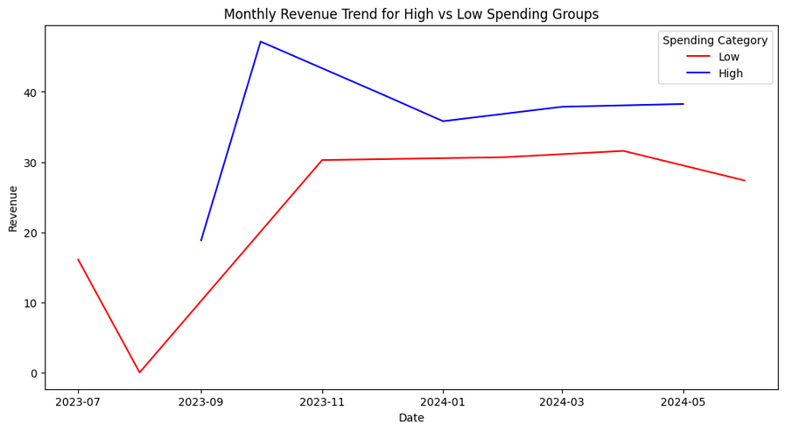
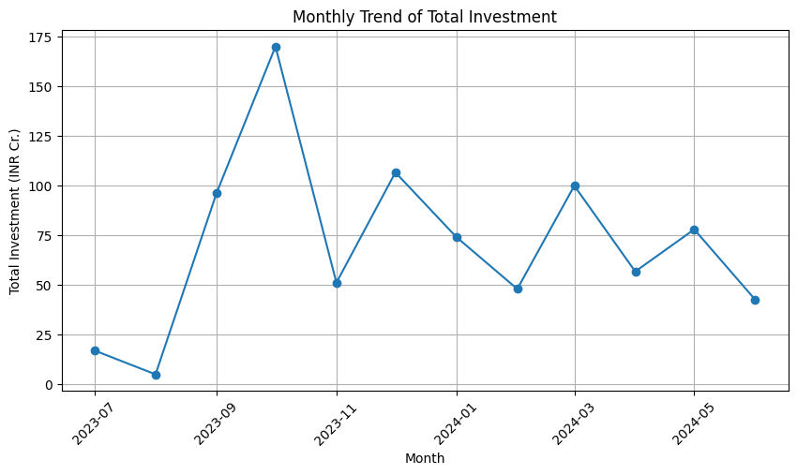
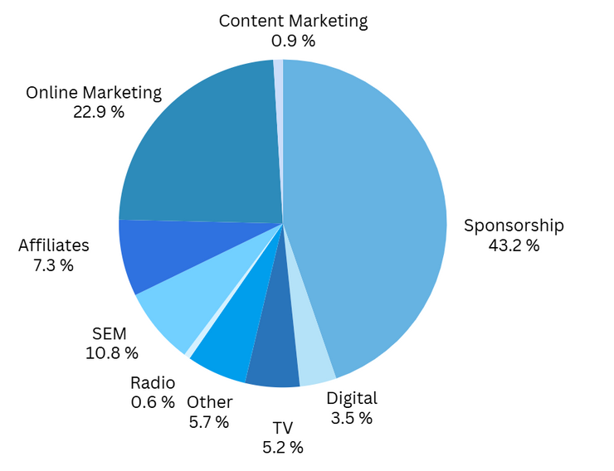
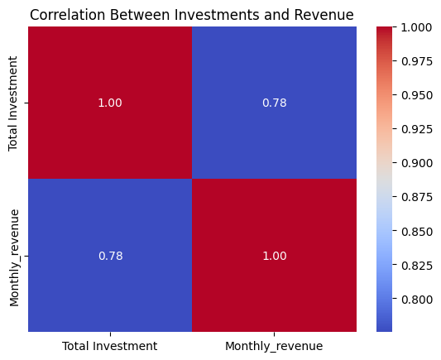
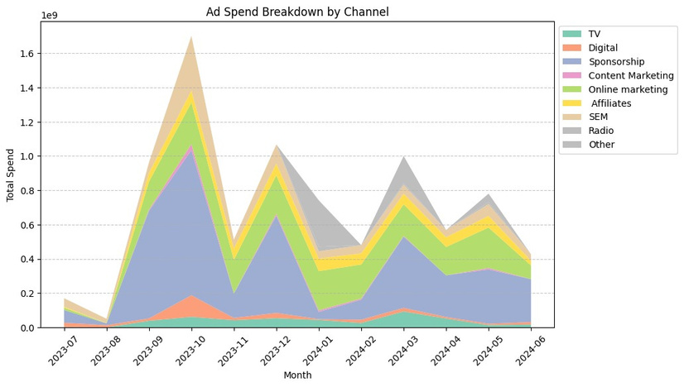
MARKETING INVESTMENT & REVENUE ANALYSIS
Monthly Revenue Trend for High vs Low Spending Groups
Monthly Trend of Total Investment
Breakdown of Investment by Channel
Trends in Ad Investments Across Channels
Investment vs. Revenue
Breakdown of Investment by Channel

Slide 7
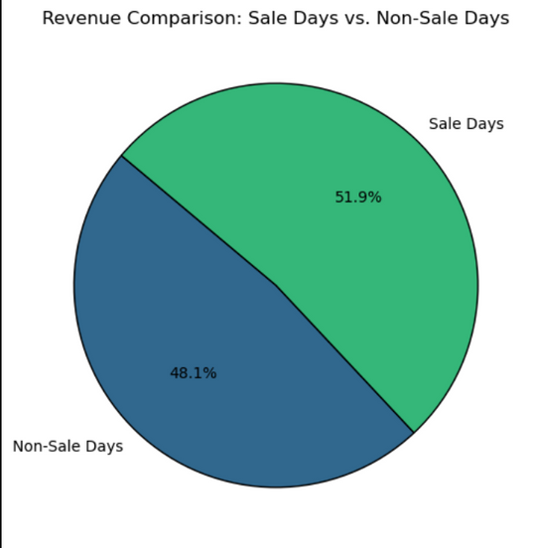
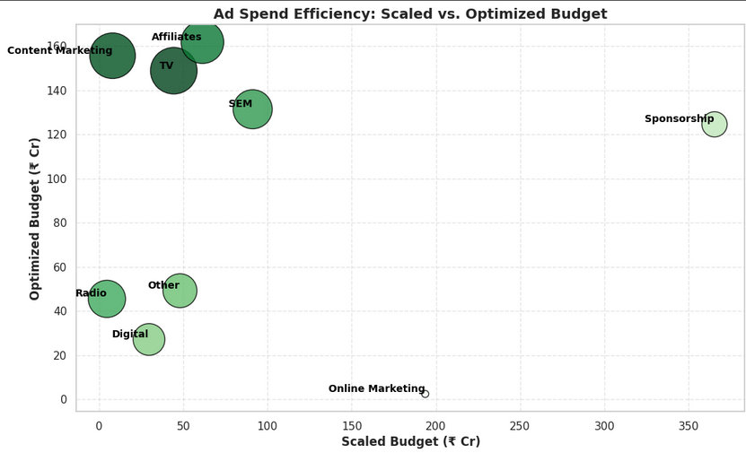
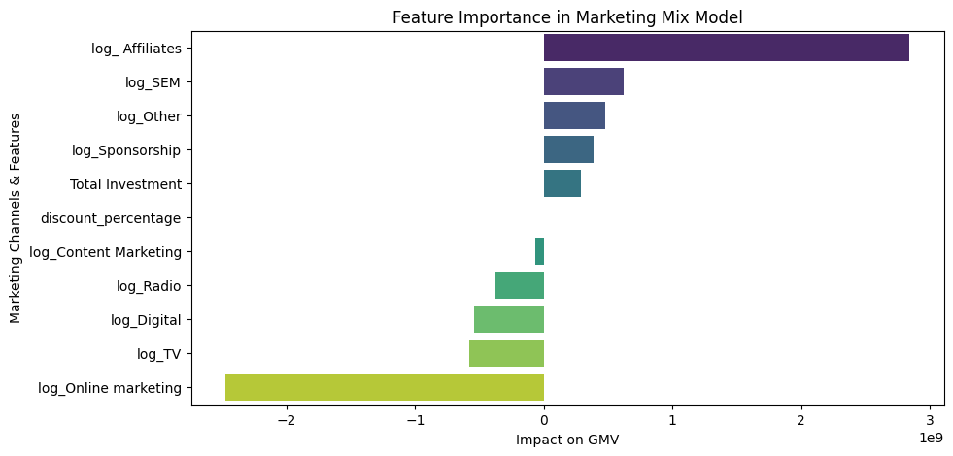
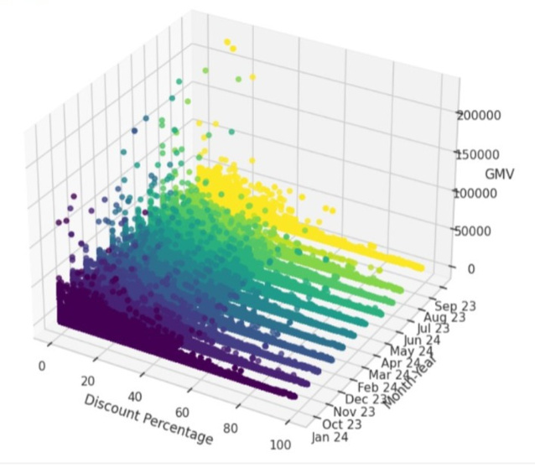
IMPACT OF SALES & DISCOUNT
Impact of Discounts on GMV Over Time

Slide 8
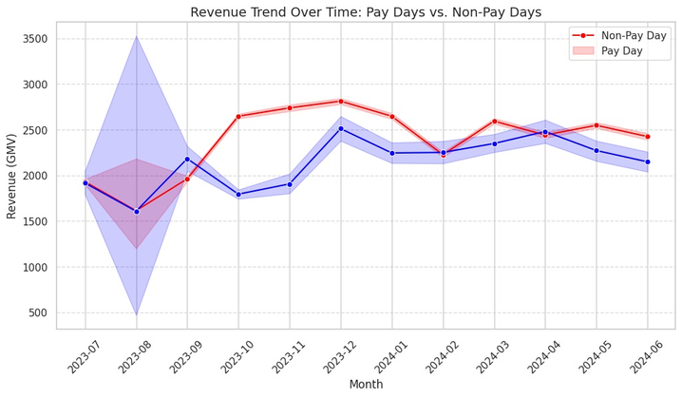
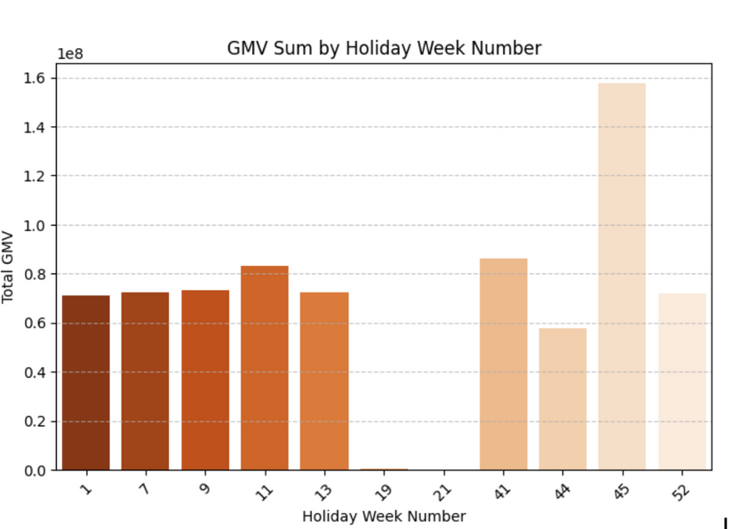
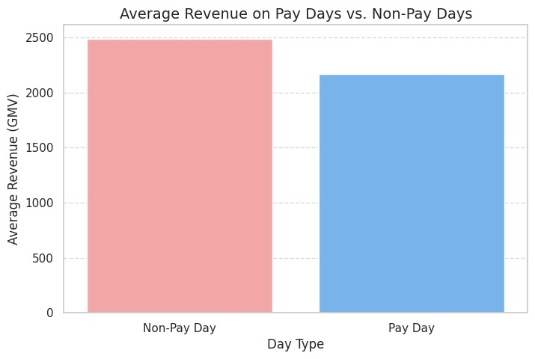
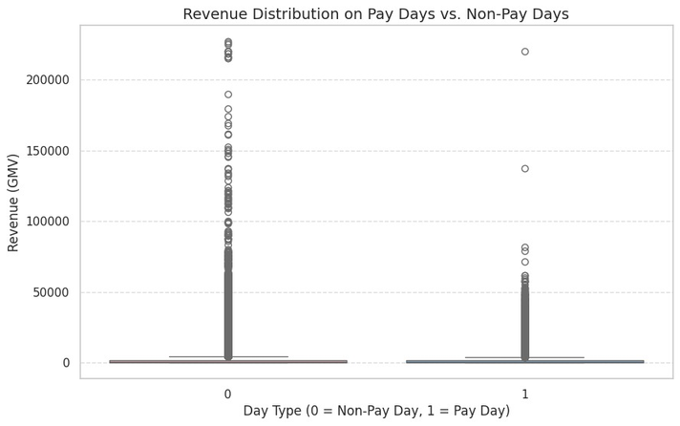
REVENUE TRENDS: PAY DAYS AND HOLIDAYS
GMV peaks during major holidays (Weeks 45 & 52), with moderate spikes around Halloween, steady early-year sales, and lows in weeks with minor holidays.
Revenue on both pay and non-pay days shows a similar median, but pay days have fewer extreme outliers, indicating slightly less variability.
Revenue is consistently higher on non-pay days than on pay days, with smaller fluctuations over time.
Pay Day and Non Pay Day Revenue
Revenue distribution is similar on pay and non-pay days, but both have high-value outliers, with occasional revenue spikes.

Slide 9
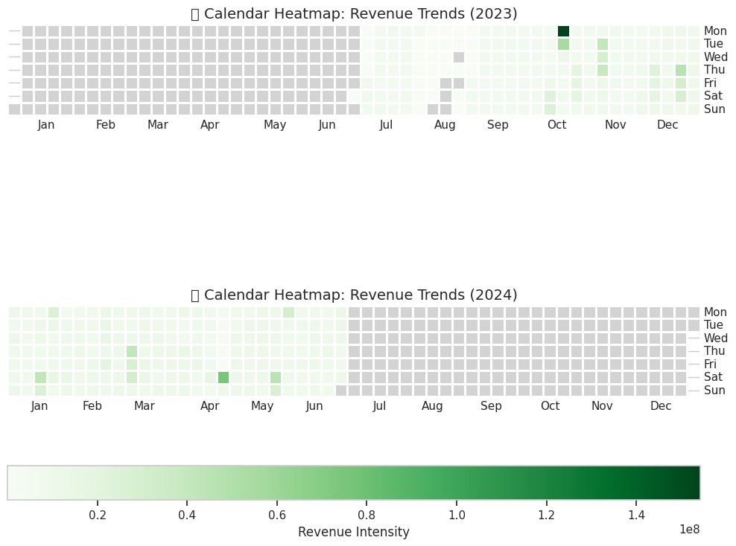
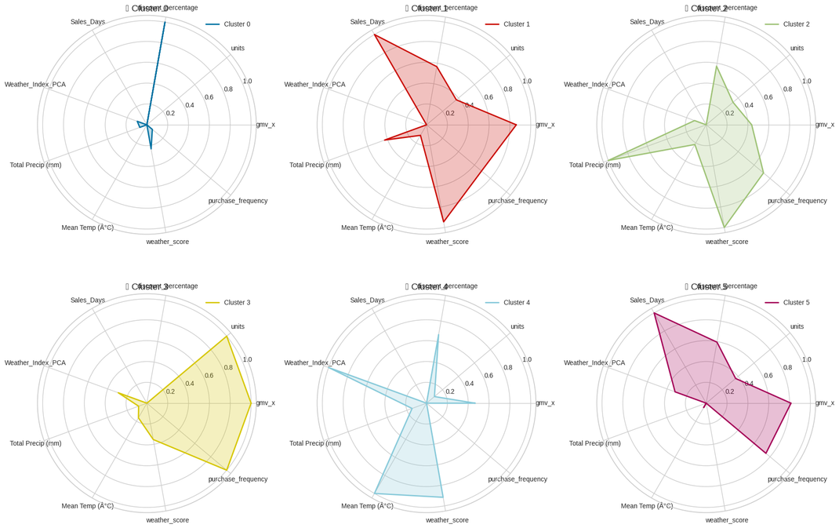
KEY DATA PATTERNS & TRENDS
Calendar Heatmap
Radar Plot
Each block represents a day, with darker shades indicating higher revenue generated on that day.
Radar plots show how key factors like units sold, discount percentage, and weather score vary across daily data clusters, highlighting unique patterns in each cluster.

Slide 10
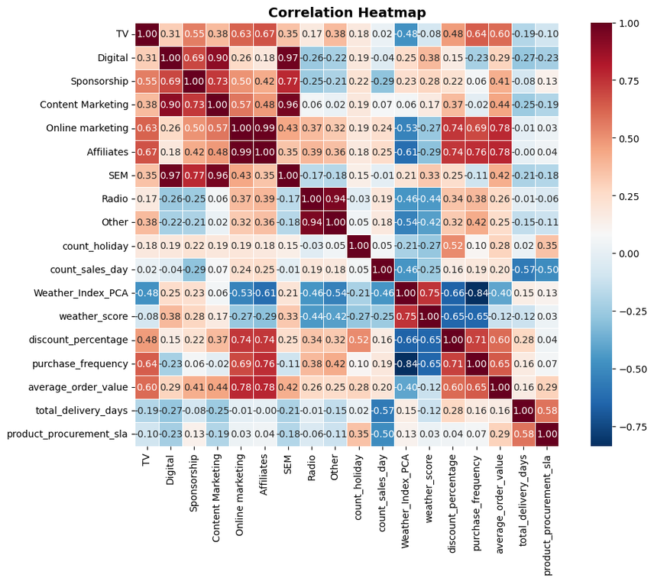
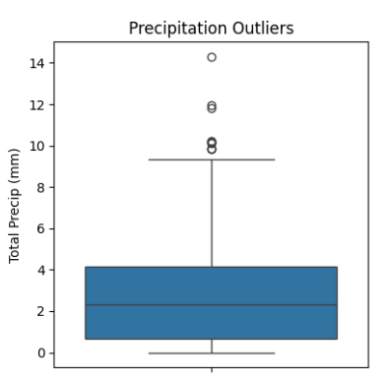
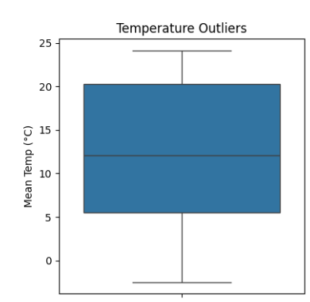
VARIABLE CORRELATIONS & OUTLIERS
Correlation Matrix
Outlier Detection
Boxplots were used to identify outliers in temperature and precipitation.
Unusual temperature spikes or extreme precipitation events were flagged for further investigation.
The heatmap shows pairwise correlations between variables, with warm colors (red) indicating strong positive relationships and cool colors (blue) indicating strong negative ones. This helps identify patterns, dependencies, and potential multicollinearity in the data.
Several extreme precipitation values indicate unusually high rainfall events, while temperature data shows no significant outliers, suggesting stable variations.

Slide 11
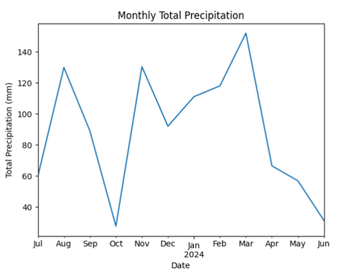
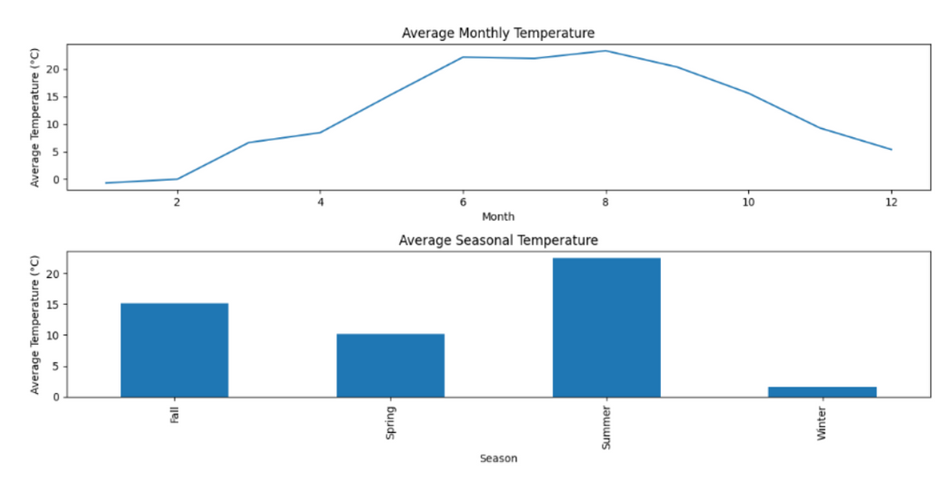
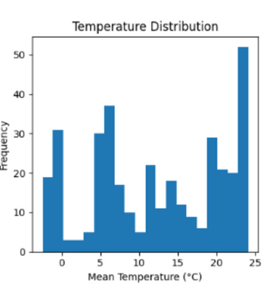
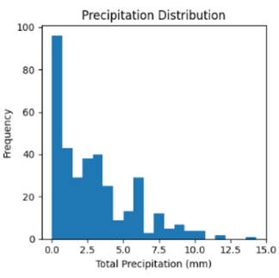
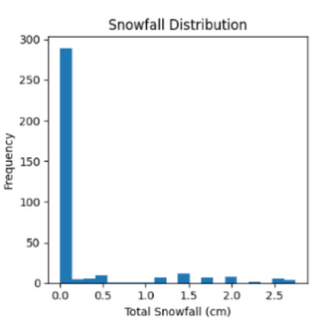
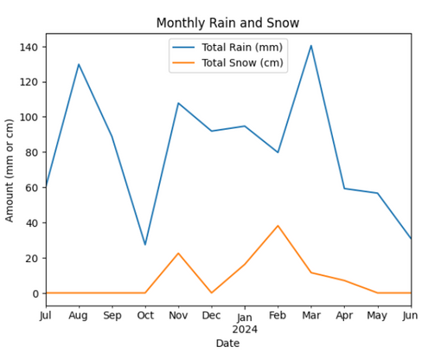
SEASONAL WEATHER PATTERNS
Seasonal Trends
Monthly Total Precipitation
Precipitation peaks in August, November, and March, with March 2024 highest, showing seasonal variation and wetter winters and late summers.
Temperature, Precipitation, and Snowfall Trends
Monthly Rain and Snow Trend
Rainfall peaks in August and March, while snowfall is highest in November and February, showing an inverse, seasonal pattern.
The histogram analysis revealed the distribution of average temperature, precipitation, and snowfall, assessing normality and flagging extreme values.

Slide 12
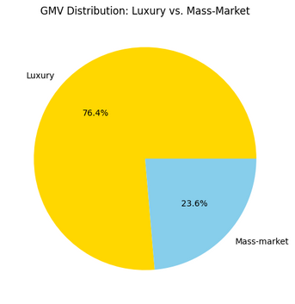
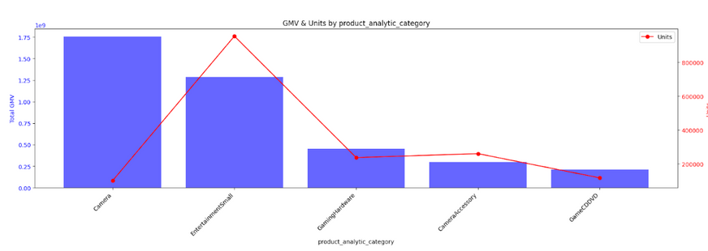
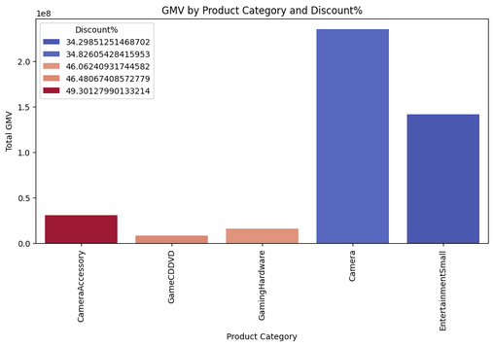
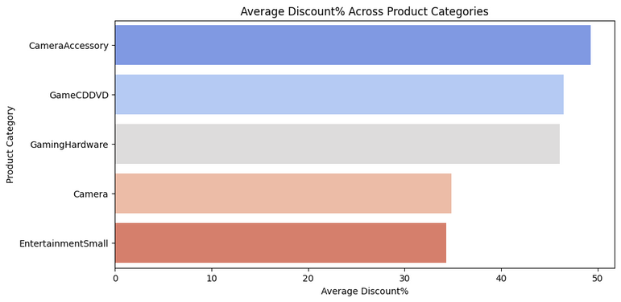
Revenue Insights: Categories, Luxury vs. Mass-Market, and Discounts
Category-Wise Revenue & Units
Luxury vs. Mass-Market Product Sales
Luxury products dominate GMV, contributing 76.4%.
Mass-market products account for only 23.6%, suggesting lower revenue contribution.
High-value products drive overall revenue, making luxury a key segment for profitability.
Cameras dominate GMV, followed by EntertainmentSmall with strong market interest.
GamingHardware is a niche but valuable segment.
Camera Accessories & GameCD/DVD have lower GMV due to sales volume or pricing.
EntertainmentSmall sees high unit sales despite lower GMV.
Discount Effect on Different Categories
Camera Accessories, GameCDDVD, and Gaming Hardware have the highest discounts but generate lower GMV.
Camera and EntertainmentSmall have relatively lower discounts but dominate GMV
Moderate discounts indicate strong demand, while high discounts don't always boost revenue.
High-value electronics drive revenue, making them essential for strategic focus.

Slide 13
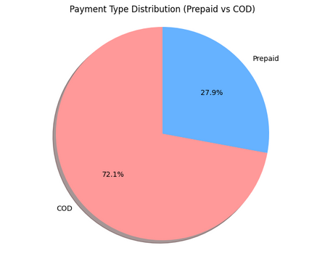
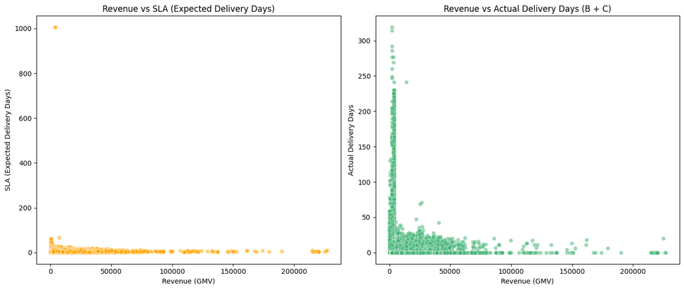
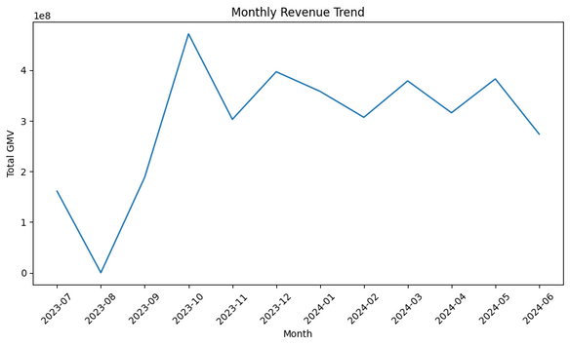
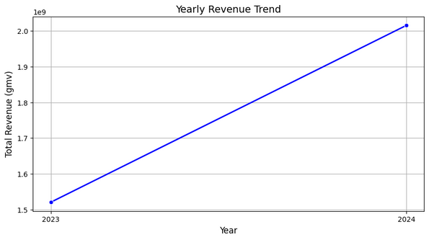
Order Fulfillment, Payment Preferences & Revenue Trends
Revenue vs. SLA & Delivery Days
Payment Type (Prepaid vs. COD) Distribution
Cash on Delivery (COD) accounts for 72.1% of transactions while only 27.9% of orders are prepaid.
There is a strong preference for post-payment purchases.
Revenue growth
Most expected delivery times (SLA) are concentrated at lower values.
Actual delivery days tend to be higher than expected for some transactions.
Higher revenue orders have longer delivery times. Many orders exceed expected delivery times. Lower delivery time has given lesser revenue.
Revenue spiked in Oct 2023, fluctuated in early 2024, peaked in Mar & May, then declined in June.
Revenue (GMV) increased significantly from 2023 to 2024 in a linear trend.
High-value orders are prioritized for faster delivery while lower-value orders frequently experience fulfillment delays.
The business has experiencing consistent overall revenue growth but with noticeable monthly volatility.

Slide 14
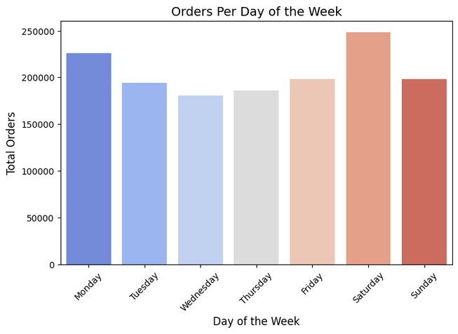
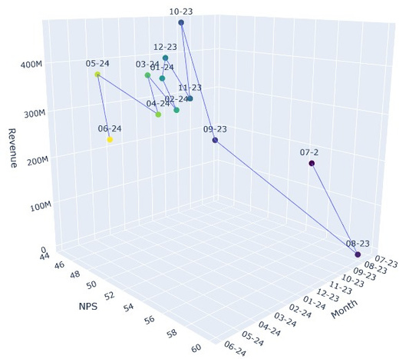
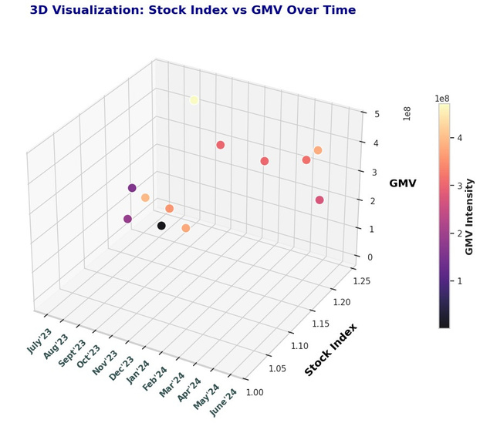
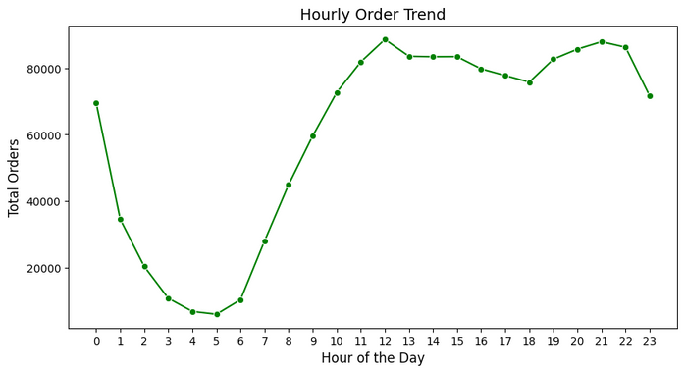
Order and Revenue Trends: Daily, Hourly, and Seasonal Insights
Orders Per Day of the Week
3D Trend of NPS, Revenue, and Time
Saturday sees the highest order volume, followed by Monday, while midweek (Tuesday-Thursday) experiences lower orders. Friday and Sunday are moderate, with a slight dip on Sunday.
Revenue peaks in Oct 2023, May 2024, and June 2024 suggest promotions, seasonal demand, or market influences.
Certain months see higher GMV due to seasonal trends, promotions, or market influences, making them key for strategic sales planning.
Hourly Order Trend
Orders peak around midnight, drop sharply until early morning, then rise steadily after 6 AM, peaking between 12 PM - 1 PM before stabilizing in the afternoon with a slight evening dip.

Slide 15


FEATURE ENGINEERING

Slide 16




FEATURE ENGINEERING
Category & Customer Insights Features
Product Category Performance Score = Total Revenue from Category / Total Units Sold
Luxury vs. Mass-Market Products = Defined by GMV > 80th percentile
Customer Retention Rate = (Repeat Customers / Total Customers) × 100
Order Frequency Score = Total orders per customer over a set period
Sale Period Flag = 1 if order falls within a sale period, else 0
Sales & Pricing Features
List Price = GMV * Units
Discount % = 100 × (Product MRP – List Price) / Product MRP
Delivery Time (Total) = Deliverybdays + Deliverycdays
Customer Purchase Frequency = Total orders per customer
Average Order Value (AOV) = GMV / Total Orders
Revenue = ∑GMV (analyzed monthly, during sales, payday weeks, holidays, etc.)
Seasonality & External Impact Features
Payday Week Flag = 1 if order falls within payday week, else 0
Holiday Week Flag = 1 if order falls within a holiday period, else 0
NPS Growth Rate = Current Month NPS - Previous Month NPS
Revenue Change % = (Current Month Revenue - Previous Month Revenue) / Previous Month Revenue
Weather-Based Feature Engineering
Extreme Temperature Flag → 1 if Max Temp < -3°C or >23°C, else 0.
Rainy Day Indicator → 1 if Total Rain > 0, else 0.
Snowy Day Indicator → 1 if Total Snow > 0, else 0.
7-Day Rolling Avg Temp → Captures temperature trends over a week.
Lag Features → Yesterday’s temperature & precipitation to analyze weather persistence effects.
Weather Impact Index → Custom score based on temperature deviation, wind speed, and precipitation to assess extreme weather effects on sales.

Slide 17
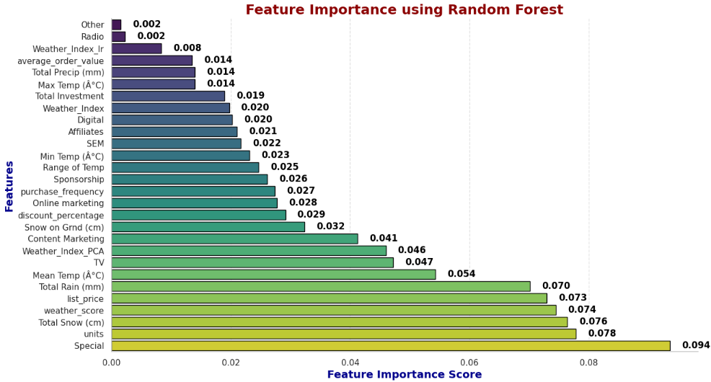
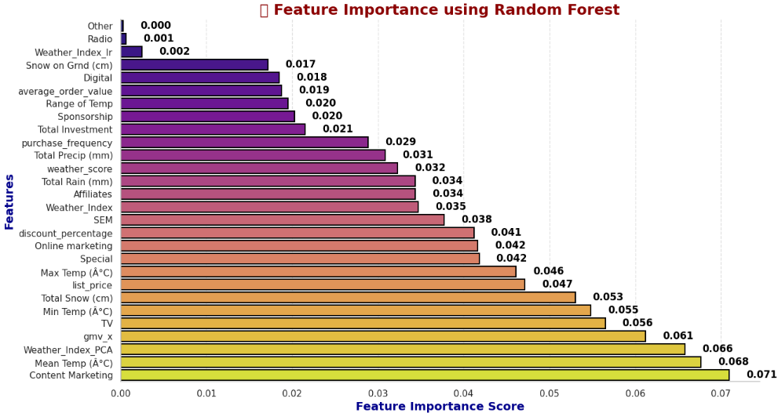
FEATURE ENGINEERING
Based on GMV
Based on units
Units sold, special events, and total snowfall are the top drivers of GMV, indicating sales and weather significantly impact revenue.
Special events, GMV, and discounts are key influencers of units sold, highlighting the importance of promotions and event-driven strategies.

Slide 18

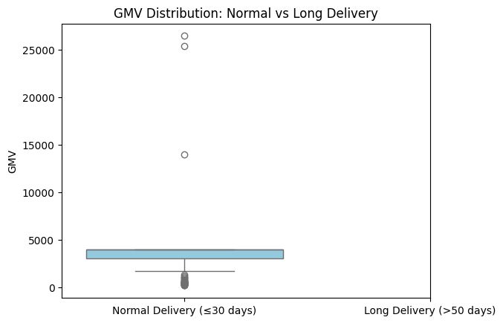
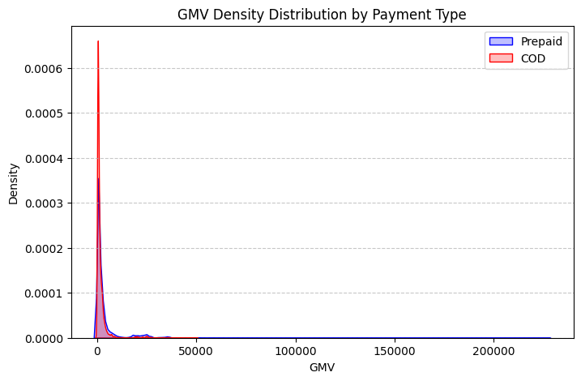
HYPOTHESIS TESTING
Impact of Delivery Time on GMV
Extreme Weather Conditions Drive Higher GMV
Weather does not impact order volume (p = 1.000) but significantly affects GMV (p < 0.001)
Extreme weather (high/low temps) sees higher GMV, while moderate weather has the lowest.
Long delivery orders (>50 days) have higher GMV (₹3522.89 vs. ₹2469.22) but are rare (518/14L).
Small effect size (d = 0.254) limits overall GMV impact despite significance.
Prepaid Orders Drive Higher GMV
Prepaid orders generate significantly higher GMV than COD (p ≈ 0)
Despite fewer prepaid orders, they have higher spending, suggesting incentives can boost revenue..

Slide 19
BUDGET OPTIMIZATION

Slide 20
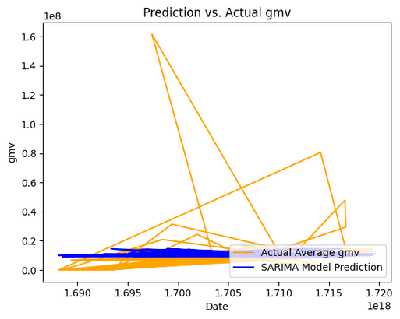
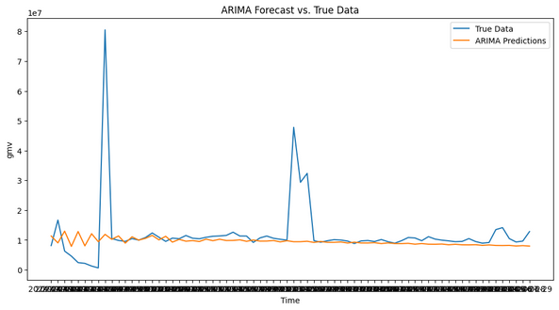
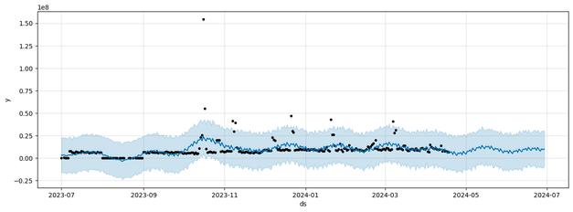
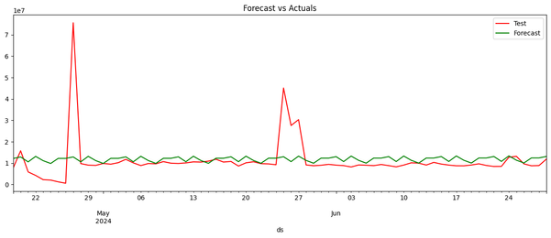
TIME SERIES FORECASTING
SARIMA
ARIMA
PROPHET
LSTM
Chosen to capture seasonal patterns in GMV.
Optimal order (2,0,1)(0,1,1,12) determined from ACF, PACF & Dickey-Fuller tests
Rolling forecast approach achieved MAPE of 10%.
Chosen for trend-based GMV prediction.
Manual grid search (p=9, d=1, q=3) & Mango library optimization.
Achieved MAPE of 16.09% by hyperparameter tuning
Decomposes time series into trend & seasonality using date & GMV.
Integrated Canadian holidays to improve accuracy.
Achieved 30% MAPE by hyperparameter tuning.
Captured temporal dependencies for GMV prediction.
Integrated weather, customer orders, and other factors.
Hyperparameter tuning achieved 64.8% MAPE.

Slide 21
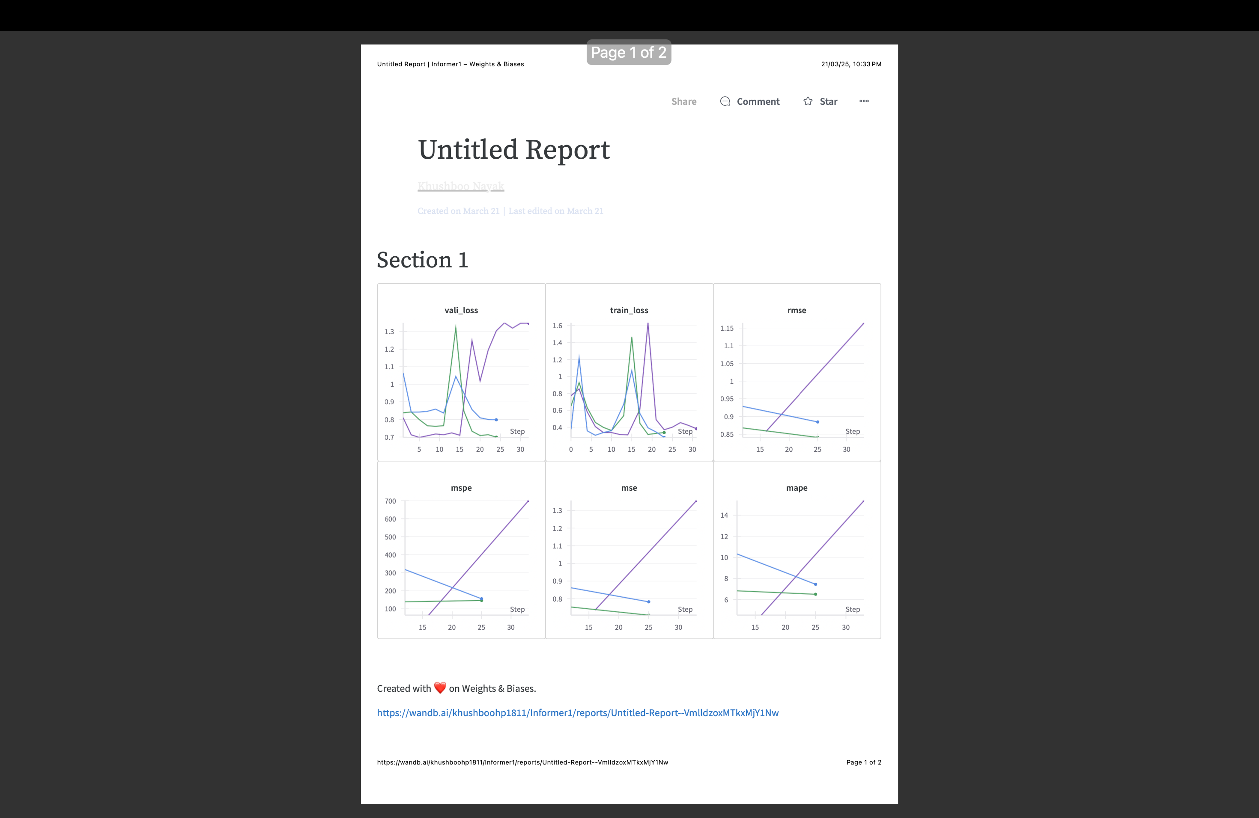
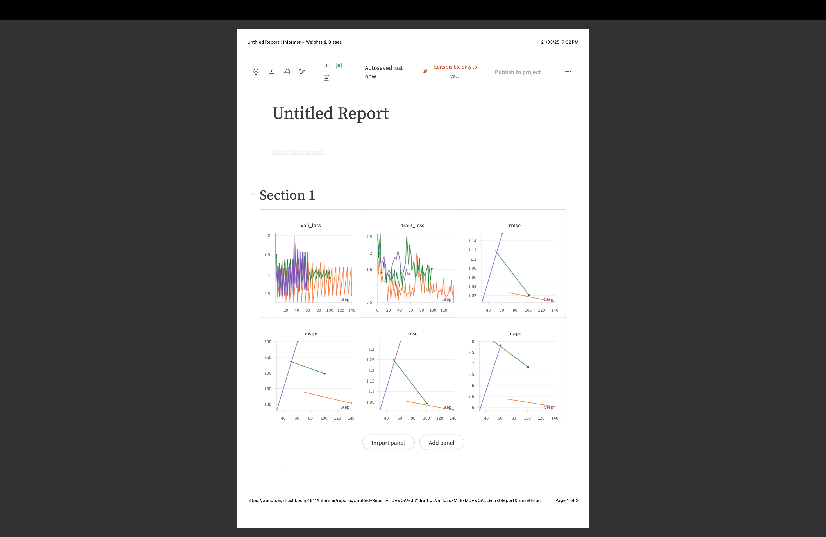
TIME SERIES FORECASTING
INFORMER
AUTOFORMER
Addresses the limitations of Transformer-based models in long-sequence forecasting.
Trained for 6 epochs with early stopping.
Performance gains over ARIMA & SARIMA by leveraging multivariate data & reducing computations.
Designed to decompose the time series into trend and seasonal components.
Trained for 10 epochs with early stopping.
Performance gains over Informer Model as it uses Auto-Correlation attention instead of dot-product attention.

Slide 22
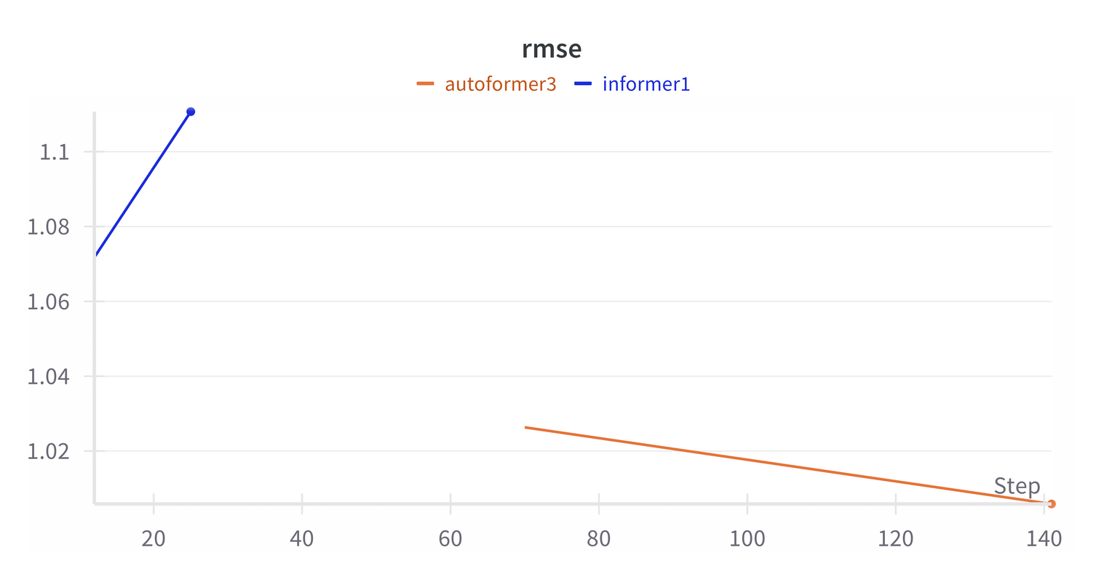
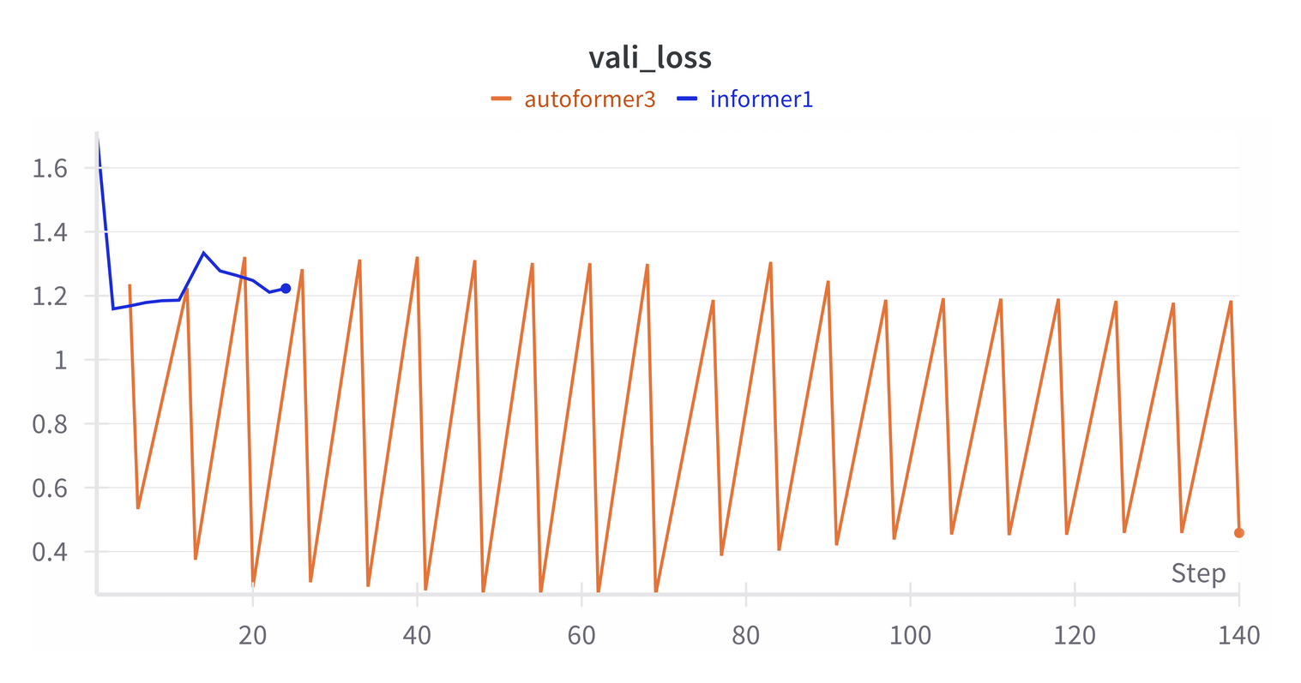
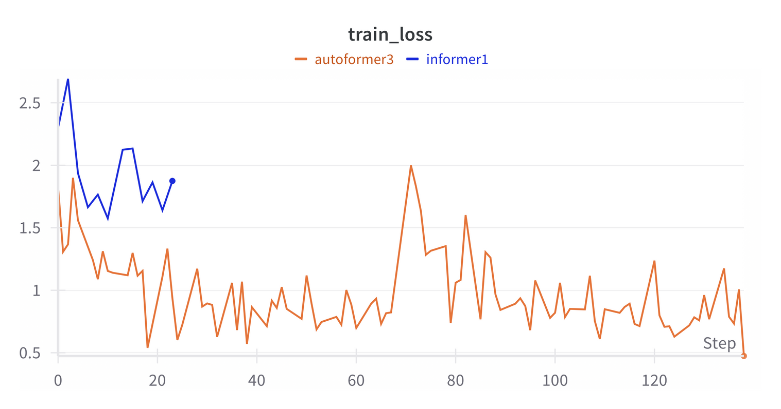
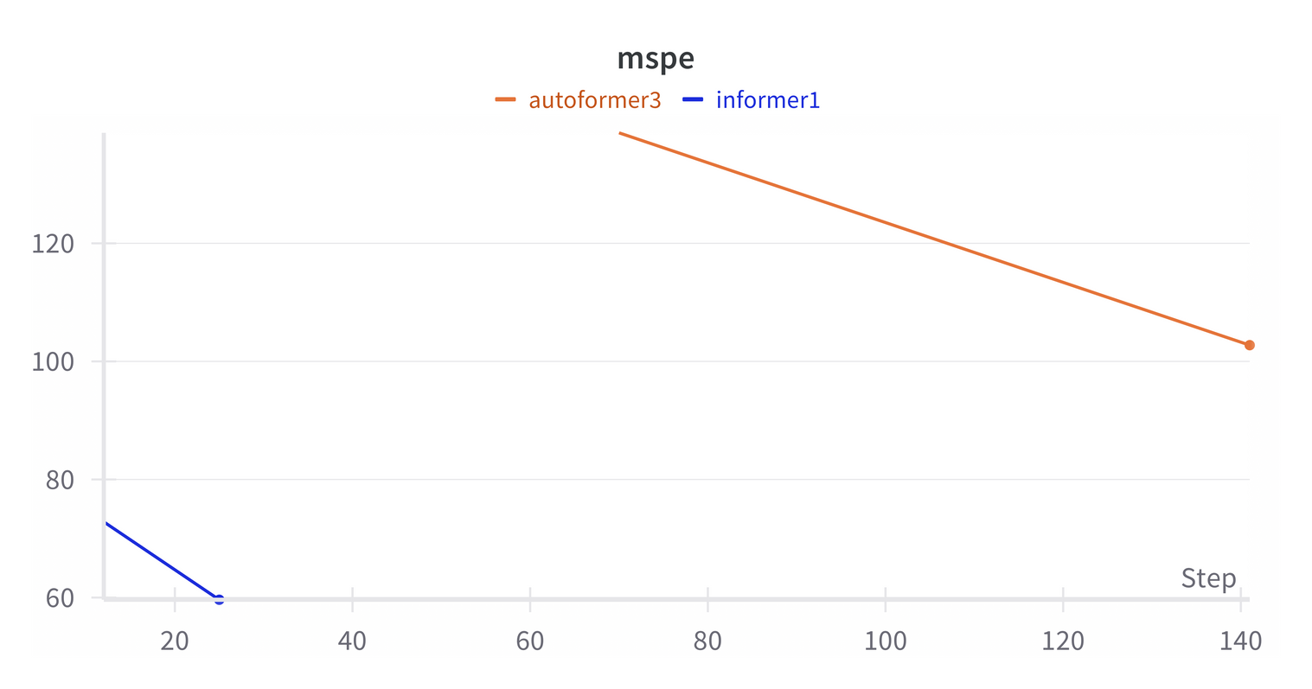


AUTOFORMER v/s INFORMER

Slide 23
SOLUTION 1: BUDGET REDUCTION
CHANNELS & EXT. FACTORS
DATA PREPARATION
ADSTOCK (DECAY = 0.3)
ROI = PROFIT / INVESTMENT
DATA
BAYESIAN MMM
BAYESIAN INFERENCE
ROI ESTIMATION
PREDICT REVENUE USING ROI + INITIAL SPEND
DATA CLEANING
MAXIMIZE PROFIT
REVENUE CONSTRAINT: ±5% OF ORIGINAL
BAYESIAN OPTIMIZATION
POST-OPTIMIZATION ANALYSIS
BUDGET ADJUSTMENT:
80% – 120% RANGE
PREDICTED TOTAL INVESTMENT BUDGET
CHANGE BUDGET
PROPORTIONALLY TO ROI
VISUALIZE BUDGET SHIFTS PER CHANNEL
MCMC SAMPLING
FUTURE REVENUE PREDICTION
FUTURE ROI PREDICTION
FUTURE BUDGET PREDICTION PER CHANNEL
BAYESIAN PRIORS

Slide 24
BUDGET REDUCTION STRATEGY
1
2
Bayesian ROI Estimation
Bayesian ROI Estimation
Defined marketing channels & external factors.
Applied adstock (decay = 0.3) for carryover effects.
Set Bayesian priors for base revenue, channels, and external effects.
Modeled revenue using PyMC; sampled with NUTS (3,000 samples, 4 chains).
Estimated channel-wise ROI via Bayesian inference.
ROI = Profit / Investment per channel
Predicted original revenue from estimated ROIs.
3
4
Post-Optimization Insights
Optimization Approach
Objective: Maximize profit under ±5% revenue constraint.
Penalty applied for constraint violation
Optimized spend using Bayesian optimization.
Spend Bounds: 80%–120% of original per channel.
Compared original vs. optimized spend, revenue, and profit.
Visualized budget shifts across channels.
Reallocated budget proportionally based on ROI.

Slide 25
Channel | Prev ROI (%) | Optimized ROI (%) | ROI Improvement (%) | Previous Investment (in Cr.) | Predicted Investment (in Cr.) | Profit in Investment (in Cr.)
Online Marketing | -84.41 | -99.45 | -15.04 | 61.36 | 15.65 | +45.71
SEM | -90.30 | -75.59 | 14.71 | 4.67 | 4.47 | +0.20
Affiliates | -93.35 | -72.81 | 20.53 | 91.20 | 13.51 | +77.69
Content Marketing | -99.06 | -73.25 | 25.81 | 193.64 | 39.35 | +154.29
Sponsorship | -78.57 | -81.80 | -3.23 | 8.03 | 7.99 | +0.04
Other | -93.67 | -86.53 | 7.14 | 353.59 | 105.44 | +248.15
TV | -93.52 | -65.89 | 27.62 | 29.66 | 3.22 | +26.44
Radio | -99.35 | -87.48 | 11.87 | 48.02 | 6.76 | +41.26
Digital | -95.64 | --91.39 | 4.25 | 365.37 | 183.45 | +181.92

Slide 26
SOLUTION 2: BUDGET REALLOCATION
CALCULATE MONTHLY PREDICTED GMV
DATA PREPARATION
CALCULATE MONTHLY PRESENT GMV
ROI = PROFIT / INVESTMENT
DATA
BAYESIAN MMM
BAYESIAN INFERENCE
ROI ESTIMATION
PREDICT REVENUE USING ROI + INITIAL SPEND
DATA CLEANING
DIFFERENTIAL EVOLUTION
POST-OPTIMIZATION ANALYSIS
CONSTRAINED
OPTIMIZATION
BUDGET PROPORTIONS MUST SUM TO 1
CHANGE BUDGET
PROPORTIONALLY TO ROI
VISUALIZE BUDGET SHIFTS PER CHANNEL
PREDICTED TOTAL INVESTMENT BUDGET
OBJECTIVE FUNCTION WITH PENALTY
OPTIMAL BUDGET ALLOCATION
FUTURE ROI PREDICTION
FUTURE BUDGET PREDICTION PER CHANNEL
BAYESIAN PRIORS

Slide 27
BUDGET REALLOCATION STRATEGY
1
2
Bayesian ROI Estimation
Bayesian ROI Estimation
Calculated predicted revenue using time series model
Calculated Bayesian Priors from model
Modeled revenue using PyMC; sampled with NUTS (3,000 samples, 4 chains).
Estimated channel-wise ROI via Bayesian inference.
ROI = Profit / Investment per channel
Predicted original revenue from estimated ROIs.
3
Optimization Approach
4
Post-Optimization Insights
Differential Evolution: A constrained optimization problem by keeping budget proportions sum as 1
Objective function: Balances revenue maximization with a penalty for violating budget constraints.
Compared original vs. optimized spend, revenue, and profit.
Visualized budget shifts across channels.
Reallocated budget proportionally based on predicted coefficients.

Slide 28
Channel | Prev ROI (%) | Optimized ROI (%) | ROI Improvement (%) | Predicted Investment (in Crores) | Previous Investment (in Crores) | Increase in revenue (in Crores)
TV | -84.41 | -82.72 | 1.69 | 17.03 | 61.36 | 0.53
Content Marketing | -90.30 | -82.17 | 8.13 | 77.52 | 4.67 | 2.40
Affiliates | -93.35 | -88.66 | 4.69 | 34.88 | 91.20 | 1.08
SEM | -99.06 | -96.68 | 2.38 | 20.17 | 193.64 | 0.63
Radio | -78.57 | -76.29 | 2.28 | 23.72 | 8.03 | 0.73
Other | -93.67 | -59.48 | 34.19 | 309.41 | 353.59 | 9.60
Digital | -93.52 | -59.85 | 33.67 | 303.98 | 29.66 | 9.43
Sponsorship | -99.35 | -97.56 | 1.79 | 14.68 | 48.02 | 0.46
Online Marketing | -95.64 | -90.57 | 5.07 | 45.12 | 365.37 | 1.40

Slide 29


PRODUCT CATEGORIES TO TARGET FOR CAMPAIGN
The product category which has both higher revenue and higher units sold should be prioritized for campaign.
In our case it is EntertainmentSmall Product Category.
Product Analytic Category | gmv | units | revenue percentage | units percentage
Camera | 12544.93 | 86695 | 43.783577 | 5.938514
CameraAccessory | 7720.62 | 228514 | 7.324695 | 15.652963
EntertainmentSmall | 9428.10 | 835530 | 32.905401 | 57.232904
GameCDDVD | 5257.75 | 95824 | 4.988128 | 6.563841
GamingHardware | 11592.69 | 213314 | 10.998200 | 14.611779

Slide 30




TOP-SELLING PRODUCT CATEGORIES DURING HOLIDAYS
Good Friday
St. Patrick’s Day
Valentine’s Day
Leap Day
Aboriginal Day
Camera
New Year’s Day
EntertainmentSmall & Camera
Father’s Day
St. Jean Baptiste Day
Canada Day
Louis Riel Day
Civic Holiday
Islander Day
Labour Day
Heritage Day
Thanksgiving
EntertainmentSmall
Family Day
Halloween
Easter Monday
Remembrance Day
Boxing Day
Mother’s Day
Christmas Day
Victoria Day

Slide 31

(18-19th July) | EntertainmentSmall
(15-17th Aug) | EntertainmentSmall
(28-30th Aug) | Camera
(15-17th Oct) | EntertainmentSmall & Camera
(7-14th Nov) | Camera
(25 - 31th) Dec | EntertainmentSmall
(1st - 3rd) Jan | EntertainmentSmall
(20-22) Jan | Camera
(1-2 Feb) | EntertainmentSmall
(14-15 Feb) | EntertainmentSmall & Camera
(20-21 Feb) | Camera
(7-9 Mar) | Camera
(25-27 May) | Camera
LOGIC OF CAMPAIGN SELECTION
Wherever EntertainmentSmall - Revenue and Units Sold both are high
Wherever EntertainmentSmall & Camera - Revenue of Camera is high so we can’t neglect it.
Wherever Camera - Revenue of EntertainmentSmall isn’t comparable to Camera although EntertainmentSmall has higher Units Sold.

Slide 32



CAMPAIGN TO BE DONE IN EACH DURATION
Campaign Should be done for Entertainment category
Campaign Should be done for Entertainment & Camera category
Campaign Should be done for Camera category

Slide 33

PRODUCT/ PRODUCT CATEGORIES TO TARGET FOR UPCOMING CAMPAIGN
Is ‘EntertainmentSmall’ dominant (both revenue and units sold wise)?
YES
NO
Campaign EntertainmentSmall
Is revenue of Camera much more higher than that of EntertainmentSmall?
YES
NO
Campaign both Camera and EntertainmentSmall
Campaign Camera

Slide 34




OPTIMAL MARKETING CHANNEL ALLOCATION FOR EACH PRODUCT CATEGORY
New Dataframe
Rows: Month
Columns: total GMV and the total units sold in that month for a specific product type.

Slide 35


OPTIMAL MARKETING CHANNEL ALLOCATION FOR EACH PRODUCT CATEGORY
RESULT ANALYSIS
Revenue Trend:
Entertainment products generate the highest monthly revenue across all months
Purchase Frequency Trend:
From January to April, entertainment products have the highest purchase frequency
From May onward, camera products exhibit the highest purchase frequency
KEY INSIGHTS
The dominance of entertainment products in revenue suggests higher-priced items or higher sales volume in this category
The shift in purchase frequency from entertainment to cameras after April may indicate seasonal demand, marketing influences, or product launches
Further investigation into average order value, seasonal trends, and external market factors can provide deeper insights into consumer behavior

Slide 36


DASHBOARDS

Slide 37


SALES AND REVENUE DASHBOARD
INFERENCES
GMV shows strong growth from 2023 to 2024
Luxury products dominate unit sales, surpassing mass-market items
Holiday events drive GMV spikes, with notable peaks on Boxing Day & Christmas
May and April are high-selling months, contributing significantly to total units sold
SALES AND REVENUE

Slide 38

MARKETING PERFORMANCE AND ROI DASHBOARD
INFERENCES
-0.483, indicating inefficient marketing spend
Fluctuations suggest inconsistent performance
Higher investments don’t always yield better returns
Some lower investments generate higher revenues
Optimize budget allocation for better ROI efficiency
MARKETING PERFORMANCE AND ROI

Slide 39

DISCOUNT AND PRICING IMPACT DASHBOARD
INFERENCES
Average discount: 43.97%, with an average order value of 1.93K
Trend: Discounts fluctuated but stabilized recently
GMV vs Discount: High discounts don’t always drive GMV growth
Product Type: Luxury items get higher discounts than mass-market
Takeaway: Optimize discounts for profitability
DISCOUNT AND PRICING IMPACT

Slide 40

CUSTOMER BEHAVIOR & PURCHASE FREQUENCY DASHBOARD
INFERENCES
Users: 1.43M total users, 4bn GMV, 16.44% retention
Purchase Frequency: Majority are one-time buyers
Payment Preference: COD (58.42%) > Prepaid (41.58%)
Product Type & Payment: Mass-market users prefer COD, luxury users show a mix
AOV: Luxury items have a higher average order value
CUSTOMER BEHAVIOR & PURCHASE FREQUENCY

Slide 41

SPECIAL SALES & HOLIDAYS IMPACT DASHBOARD
INFERENCES
GMV Peaks: Significant rise in May, November, and December (holiday & sale periods)
Marketing Impact: Online marketing drives higher monthly revenue than content marketing
Payday Effect: Revenue shows a boost on paydays
SPECIAL SALES & HOLIDAYS IMPACT

Slide 42

WEATHER IMPACT ON SALES DASHBOARD
INFERENCES
Rain, snow, and temperature fluctuate across months, impacting sales
Higher temperatures show a positive correlation with revenue
Weather conditions influence GMV, with varying impact across months
WEATHER IMPACT ON SALES

Slide 43

PRODUCT PERFORMANCE & CATEGORY DASHBOARD
INFERENCES
Camera category leads in GMV, followed by GameCD/DVD
DSLRs and gaming consoles generate the highest GMV among product types
Discounts vary across categories, with some receiving over 45%
SLA remains stable, averaging around 5.76
PRODUCT PERFORMANCE & CATEGORY

Slide 44
THANK YOU

